Slide 1
Introduction to AI
Amanda, Noah, Jason, Zac, Clayton, Caden, Alice

Slide 2
Table of Contents
01
04
02
05
03
06
AI Overview
Static/Dynamic Binding
Types of AI in Unity
Dynamic Binding Examples
Demo Types in Unity
Deadlines

Slide 3
01
AI Overview

Slide 4
What is AI?
Artificial Intelligence (AI) is a field of science concerned with building machines that can reason, learn, and act in such a way that would normally require human intelligence or that involves data whose scale exceeds what humans can analyze.
AI enables computers and machines to simulate human learning, comprehension, problem solving, decision making, and creativity.
Benefits of AI:
Automation - factory robots, inspecting products for defects, reduce human error
Extremely fast, infinitely available, pattern recognition
Amanda Board - Penguine

Slide 5
Different Types of AI
Currently Exists:
Does Not Yet Exist:
Reactive Machines
Theory of Mind
A limited AI that reacts to different stimuli based on preprogrammed rules. Cannot learn new data, predicts based on given data - ex: Netflix Recommendation Engine
Potentially can understand the world and how other entities have thoughts and emotions. Understand intentions and predict behavior.
Limited Memory
Self Aware
Uses Deep Learning algorithms to monitor specific situations over time. Data is not saved to memory, but AI is programmed from actions of past and present data - ex: Self-driving cars
A step above theory of mind, gaining a sense of self and understanding emotions, their state of being, and predicting others’ feelings.
Amanda Board - Penguine
Notes:
Netflix recommendations: Netflix’s recommendation engine is powered by machine learning models that process the data collected from a customer’s viewing history to determine specific movies and TV shows that they will enjoy. Humans are creatures of habit.
Self-driving cars: A good example of limited memory AI is the way self-driving cars observe other cars on the road for their speed, direction, and proximity. This information is programmed as the car’s representation of the world, such as knowing traffic lights, signs, curves, and bumps in the road. The data helps the car decide when to change lanes so that it does not get hit or cut off another driver.
Theory of Mind: Human cognitive abilities are capable of processing how our own thoughts and emotions affect others, and how others’ affect us—this is the basis of our society’s human relationships. In the future, theory of mind AI machines could be able to understand intentions and predict behavior, as if to simulate human relationships.
Self Aware: Artificial intelligence and machine learning algorithms are a long way from self-awareness because there is still so much to uncover about the human brain’s intelligence and how memory, learning, and decision-making work.

Slide 6
Training Models of AI
Supervised Learning
”Inputs and outputs” - Simplest form of ML, consists of using labeled data sets to train algorithms to further classify data or predict outcomes accurately.
Unsupervised Learning
”Without human intervention” - Automate data extraction from large, unlabeled and unstructured data sets to then make their own predictions about what the data represents.
Reinforcement Learning
“Learn by doing” - performs a task through trial and error until desired response. Once desired response is given, agent receives positive reinforcement. If task is done poorly then would receive negative reinforcement.
Amanda Board - Penguine
Notes:
In supervised learning, humans pair each training example with an output label. The goal is for the model to learn the mapping between inputs and outputs in the training data, so it can predict the labels of new, unseen data. Pictures of cats -> can tell what pictures of cats are.
Unsupervised learning is different from supervised learning, which uses labeled training data. Unsupervised learning algorithms can be used for a variety of tasks, including:
Clustering and Association - Groups unlabeled data into similar groups.
An “agent” learns to perform a defined task by trial and error (a feedback loop) until its performance is within a desirable range. The agent receives positive reinforcement when it performs the task well and negative reinforcement when it performs poorly. An example of reinforcement learning would be teaching a robotic hand to pick up a ball.

Slide 7
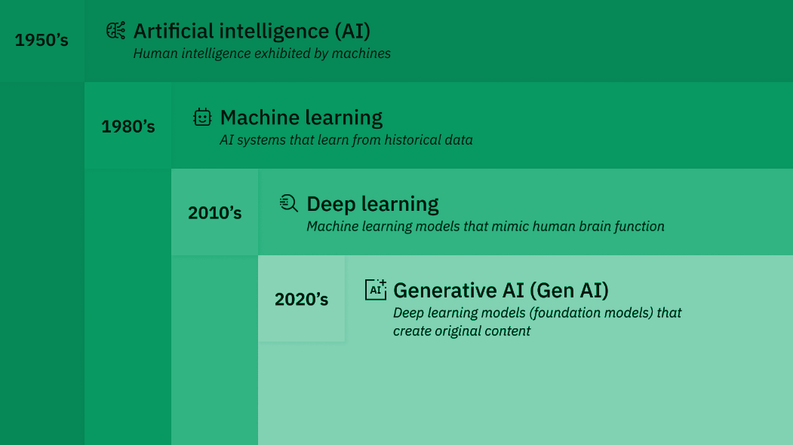
Evolution of AI
Amanda Board - Penguine

Slide 8
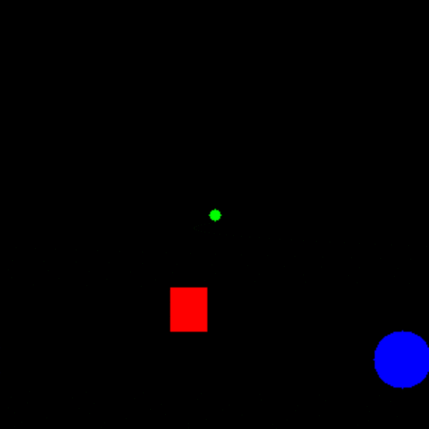
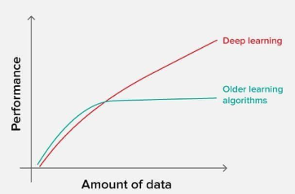
Machine Learning vs. Deep Learning
Machine Learning
Deep Learning
Umbrella Term
Make Optimized Predictions
Training Data
Reinforcement training
Supervised vs. Unsupervised
Subset of ML
Large Data Sets
Scaleable
Neural Networks
Black Box process
Noah Gerlach - MILCC’N

Slide 9
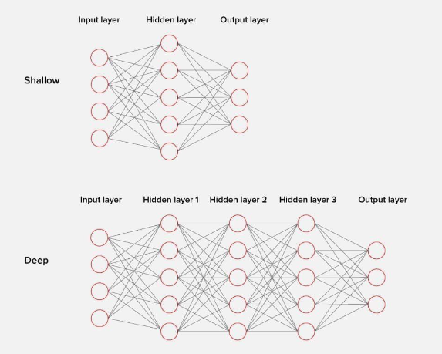
Neural Network Diagram
Noah Gerlach - MILCC’N

Slide 10
History of AI
Inception
1st Created
Major Improvement
Alan Turing’s describes his Turing Machine in 1935.
Christopher Strachey creates “Checkers” program in 1951.
IPL, LISP, and PROLOG languages designed with
AI in mind (1960-1973).
Major Improvement
Major Improvement
Modern Day
Multi-layered Neural Networks massively increased accuracy.
(1980s)
Natural Language processing with IBM Watson, Hanson’s Sophia, and assistants Siri and Alexa. (2011-2016)
OpenAI releases ChatGPT and DALL-E for generative text and images. (2020s)
Noah Gerlach - MILCC’N

Slide 11
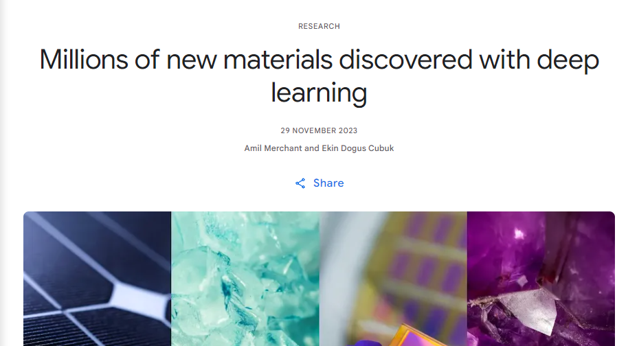
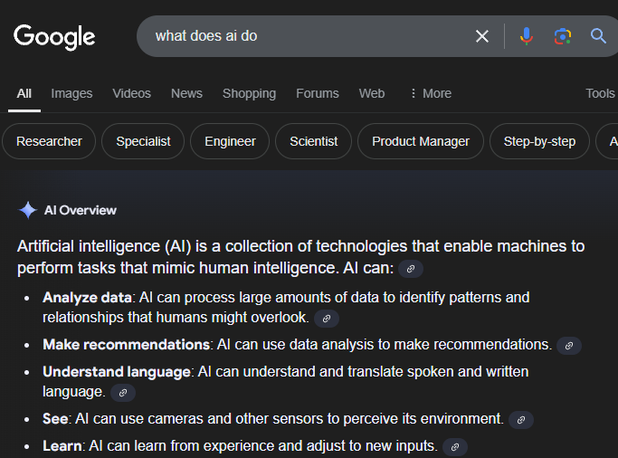
Modern Uses
General Public
Specialized Use
Digital Assistants
Spelling and grammar checks
Advertising
Online Shopping recommendations
Video Games
Search Engines
Medicinal Design (ARCH)
Inorganic Crystal Discovery (GNoME)
Protein Structure (AlphaFold)
Planned Vera C. Rubin Observatory
Noah Gerlach - MILCC’N

Slide 12
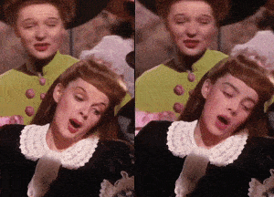
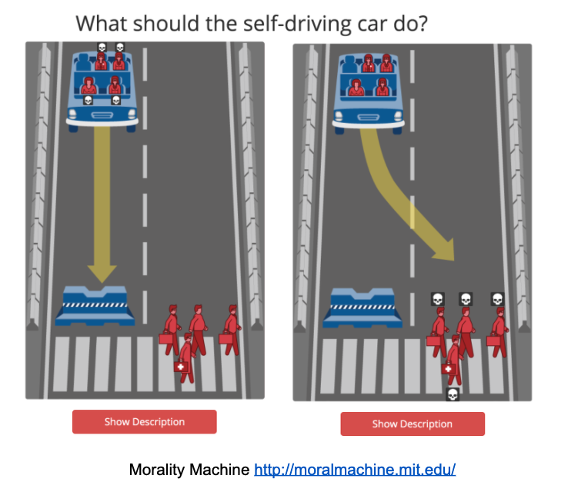
Ethics in AI
Unethical
Dilemmas
Deepfakes
Generative AI as Actual Work
Incorrect Information
Biases in Training Data
Lethal Autonomous Weapons
Copyright Uncertainty
AI & Jobs
Self Driving Cars
Noah Gerlach - MILCC’N

Slide 13
Example Ethical Dilemma
You run a popular YouTube channel where you review movies and TV shows. One day, you come across an online deepfake tool that allows you to create realistic videos of actors saying anything you’d like. Thinking it would be a fun way to preview an upcoming movie, you create a deepfake video of a beloved actor giving a glowing, exclusive interview about how excited they are for the movie.
In the deepfake, the actor praises the film, even though you haven't seen it yet. You publish the video, clearly labeling it as a “leaked interview,” and it goes viral. Viewers are thrilled by the actor's excitement and start eagerly anticipating the movie based on the fake comments. However, a week later, the actual movie releases, and it turns out to be a disappointment. Fans feel misled by your video, thinking the real actor gave a false endorsement.
What should you do next?
A. Take the video down and apologize
B. Edit the video description to clarify that it's a deepfake
C. Leave the video online as is
D. Create more deepfake content

Slide 14
02
Types of AI in Unity

Slide 15
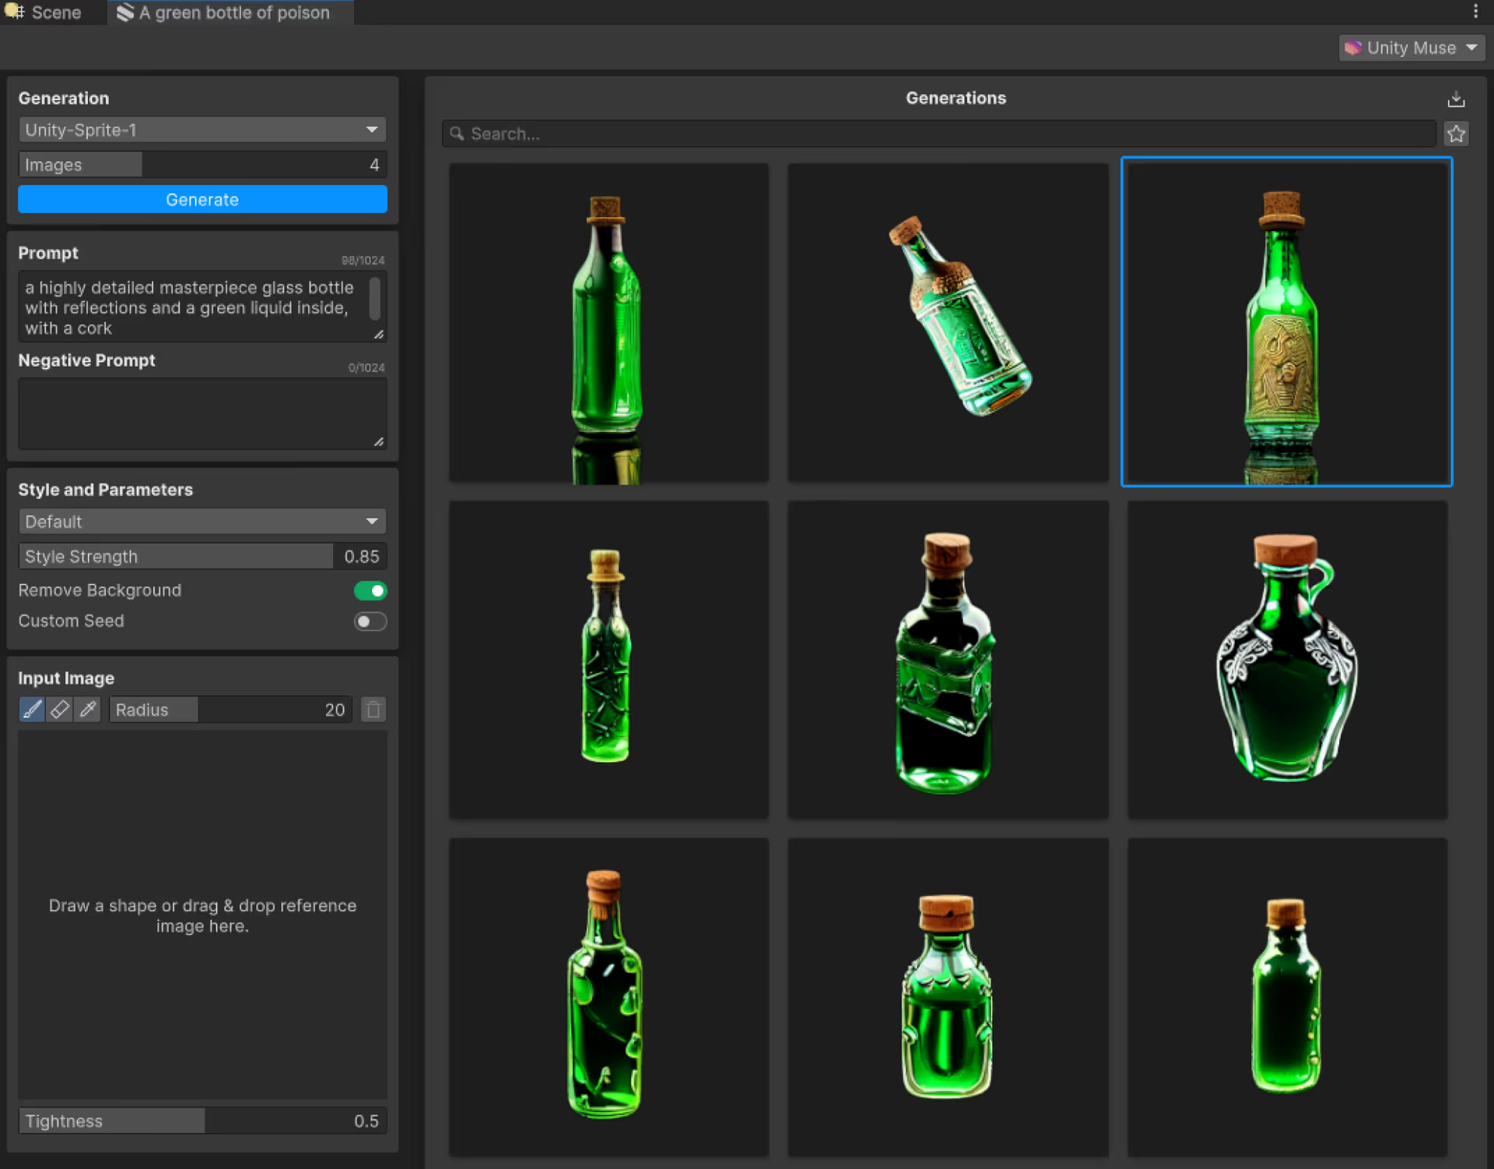
Unity Muse
Built-in generative AI
Textures
2D Sprites
Animations
Behaviors
Problem Solving
Caden Sampsel - Make It Awesome

Slide 16
Unity Sentis
Package to implement other AI models into Unity
Example use cases:
Object Identification
Handwriting Detection
AI Enemy Difficulties
AI NPC Dialogue
Caden Sampsel - Make It Awesome

Slide 17
Pathfinding
Built-in pathfinding - NavMesh
Easy to use
Very simple
Can’t do some things
A* Pathfinding Package
Tilemap
Node based
Much more complex
Caden Sampsel - Make It Awesome

Slide 18
03
Demo Modes

Slide 19
Game Demos
A short presentation to show off selected features of a game
They can involve interactive or visual representations of the game
Can be playable or non-playable
Jason Culbertson - TTK

Slide 20
Playable Demos
What?
A playable version of the game
Usually a small/limited version of the game
Requires enough development to be completed
Why?
Most engaging / interactive form of a demo
More information about the game can be collected
Bugs
Server Issues
Jason Culbertson - TTK

Slide 21
Non-Playable Demos
What?
A video or some other visual presentation of the game
Shows off features and/or narrative elements
Why?
Can be done early or late in development
Helpful marketing tool
Can be used to show progress in development
Jason Culbertson - TTK

Slide 22
04
Static/Dynamic Binding Intro

Slide 23
Static Binding
What is static binding?
Computer determining everything at compile-time
Deciding what types will be used, methods, etc
It is also called early binding
Where does static binding shine? I.E What are the best uses for it?
It improves performance because everything is assigned before running your program.
Easier to debug (don’t have to wait until the code is running to see errors)
If your program will know the type of your object or the methods it contains
How does static binding differ from dynamic binding?
Dynamic binding is called late binding
Bound at run-time, types are not assigned beforehand
Slower
Keyword “virtual” for methods
Allows for more flexibility
Alice Miller - Nautilus

Slide 24
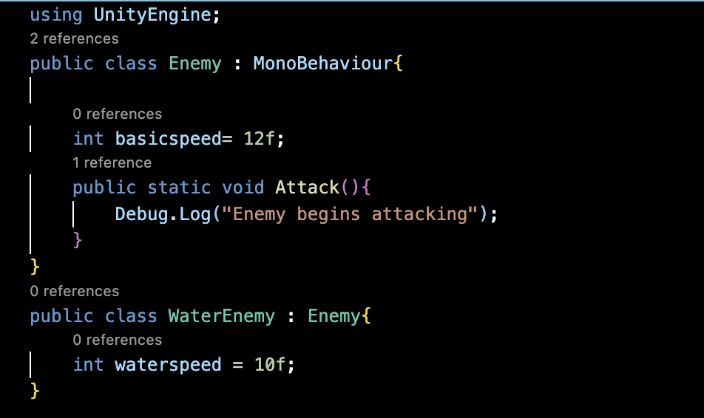
Example of Static Binding
Where could you potentially replace static binding with dynamic binding?
Enemy: have a general attack method for an enemy class, allow different subclasses of enemies to override that Attack method with their own unique attacks. Can use keywords “virtual” and “override” for your method
Basic example for static binding: here all enemies, regardless of subclass, would be using the same attack method when it’s called. The WaterEnemy could not have its own, unique Attack Method.
Alice Miller - Nautilus

Slide 25
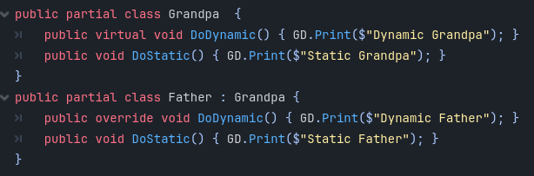
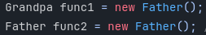
How to use Dynamic Binding
Two classes required for Dynamic binding: A superclass and subclass
EX: Grandpa and Father.
Static Type
To define a dynamically bound function, you must use the keyword “Virtual” this can be paired with the keyword “Override” to define when and what you would like bound dynamically.
Dynamic binding is performed at run time, making it slower than static binding
Dynamic Type
Clayton Slack 5 Guys

Slide 26
05
Dynamic Binding Examples

Slide 27
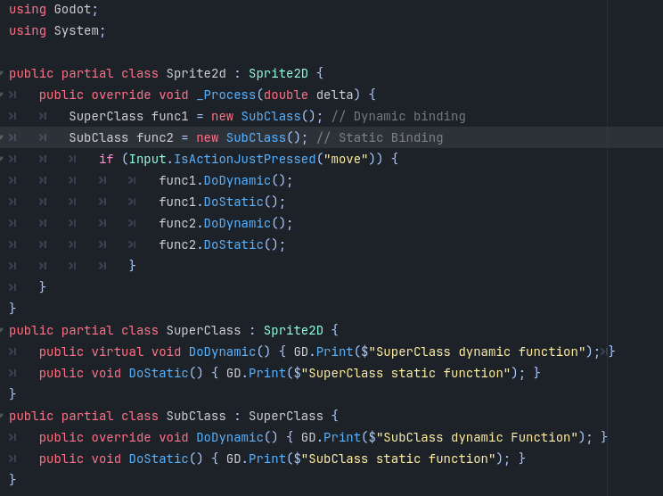
Clayton Slack 5 Guys

Slide 28
What Will the outputs be?
Clayton Slack 5 Guys

Slide 29
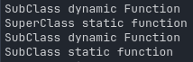
Outputs
Clayton Slack 5 Guys

Slide 30
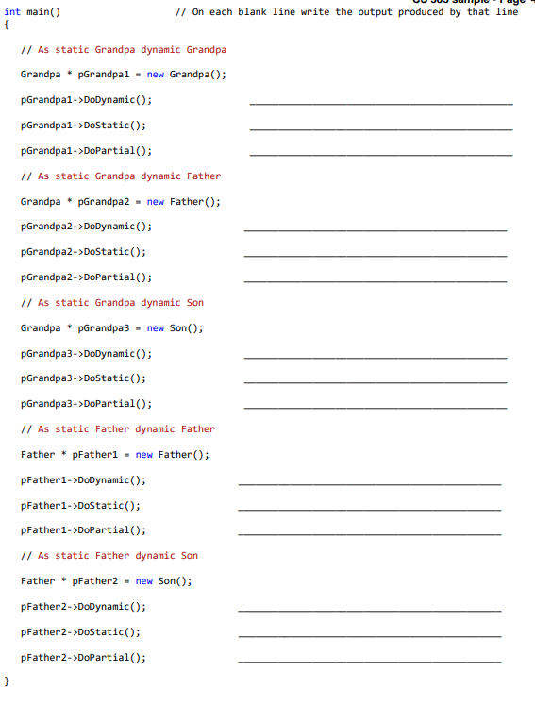
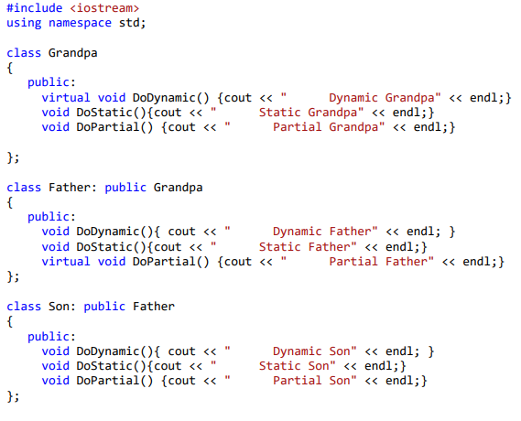
Grandpa Father son explanation
Clayton Slack 5 Guys

Slide 31
Grandpa, Father, Son Answers
Dynamic Grandpa
Static Grandpa
Partial Grandpa
Dynamic Father
Static Grandpa
Partial Grandpa
Dynamic Son
Static Grandpa
Partial Grandpa
Dynamic Father
Static Father
Partial Father
Dynamic Son
Static Father
Partial Son

Slide 32
Unity Demo
Zachary Squires - Teal Team 6
Notes:
<a href="https://www.freepik.com/free-vector/staff-people-character-grocery-shopping-customer-service-department-store-supermarket_18506783.htm#page=3&query=shopkeeper&position=45&from_view=keyword&track=ais_hybrid&uuid=1eef7512-2f13-4efc-9595-b801d973a50d">Image by felicities</a> on Freepik

Slide 33
What Do I Need For the Oral Exam?
Wow I’m so glad you asked, here is a video
DynamicBindingShadowNew.mp4
Amanda Board - Penguine

Slide 34
06
DEADLINES
Alice Miller - Nautilus

Slide 35
Timeline
10/24: TL4 Weekly Status Report
11/10-15 ORAL EXAM WEEK
Be prepared with all team lead deliverables!
10/29: TL6 Presentation
10/31: TL5 Weekly Status Report and TL5 Deliverables due
11/07 TL6 Weekly Status Report
Alice Miller - Nautilus

Slide 36
Thanks
Do you have any questions?
Please keep this slide for attribution

Slide 37
Sources
https://cloud.google.com/learn/what-is-artificial-intelligence
https://www.coursera.org/articles/types-of-ai
https://www.ibm.com/topics/artificial-intelligence
https://www.ibm.com/think/topics/ai-vs-machine-learning-vs-deep-learning-vs-neural-networks
https://www.ibm.com/think/topics/supervised-vs-unsupervised-learning
https://www.tableau.com/data-insights/ai/examples
https://www.ajmc.com/view/accelerating-drug-discovery-with-ai-for-more-effective-treatments
https://deepmind.google/discover/blog/alphafold-using-ai-for-scientific-discovery/
https://deepmind.google/discover/blog/millions-of-new-materials-discovered-with-deep-learning/
https://www.popsci.com/science/ai-astronomy/
https://www.geeksforgeeks.org/early-and-late-binding-in-c-sharp/

Slide 38
Sources
https://research.aimultiple.com/ai-ethics/
https://www.britannica.com/science/history-of-artificial-intelligence/
https://www.dataversity.net/a-brief-history-of-neural-networks/
https://www.coursera.org/articles/history-of-ai
https://blog.metaphysic.ai/deepfakes/
https://www.moralmachine.net/
https://itstamart.github.io/blog/rl-for-navigation/
https://unity.com/products/muse
https://unity.com/products/sentis
https://arongranberg.com/astar/

